Slide 2
Concurrent Hosted Services in .NET 8
Saeed Esmaeelinejad

Slide 3





About me: Saeed Esmaeelinejad Sr. Software Engineer at Seven Peaks
My profile: @sa-es-ir

Slide 4
Agenda
What is Host?
What are Hosted Services and how they work?
Hosted Services before .NET 8
New .NET 8 features for Hosted Services
Demo
Takeaways

Slide 5
What is Host?
The Host is a container which offers rich built-in services such as:
Dependency injection (DI)
Configuration
Logging
IHostedService implementations

Slide 6
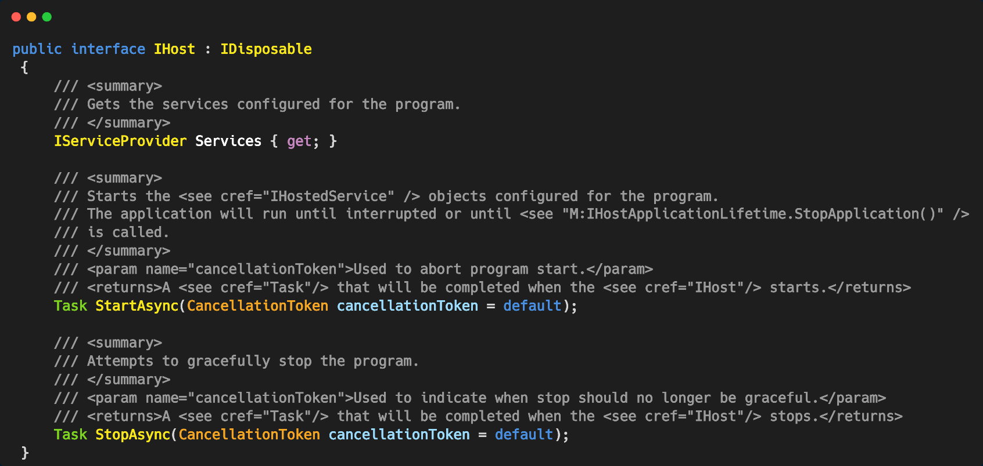
IHost interface

Slide 7
What is Host?
There are 2 types of Generic Host which can be configured to handle the activities as per your use case. Two major variations of the Host are:
Console Host
Web Host

Slide 8
What is Host?
Host is responsible for running each implementation of IHostedService. In a web app, one of the IHostedService implementations is a web service that starts an HTTP server implementation.
Including all of the app's interdependent resources in one object enables control over app startup and graceful shutdown.

Slide 9
Different parts of the Host
HOST
Logging
Configuration
Dependency Injection (DI)
Hosted Services
Service A
Service B

Slide 10
Hosted Services
A service primarily operating in the background typically lacks an interactive interface. In technical language, any object of a reference type that implements the IHostedService interface can be classified as a background, hosted, or worker service.

Slide 11
Hosted Services
Came to solve such these issues:
Periodical Background Tasks: It is used when there is a requirement to execute recurring background jobs such as cache invalidation, email notifications, system health monitoring, and data synchronization.
Application Startup Actions: Hosted service can be utilized for performing one-time actions during application startup, such as data migration or cache warm-up.
Ongoing Process Handling: It is valuable for managing continuous processes like reading messages from a queue.

Slide 12
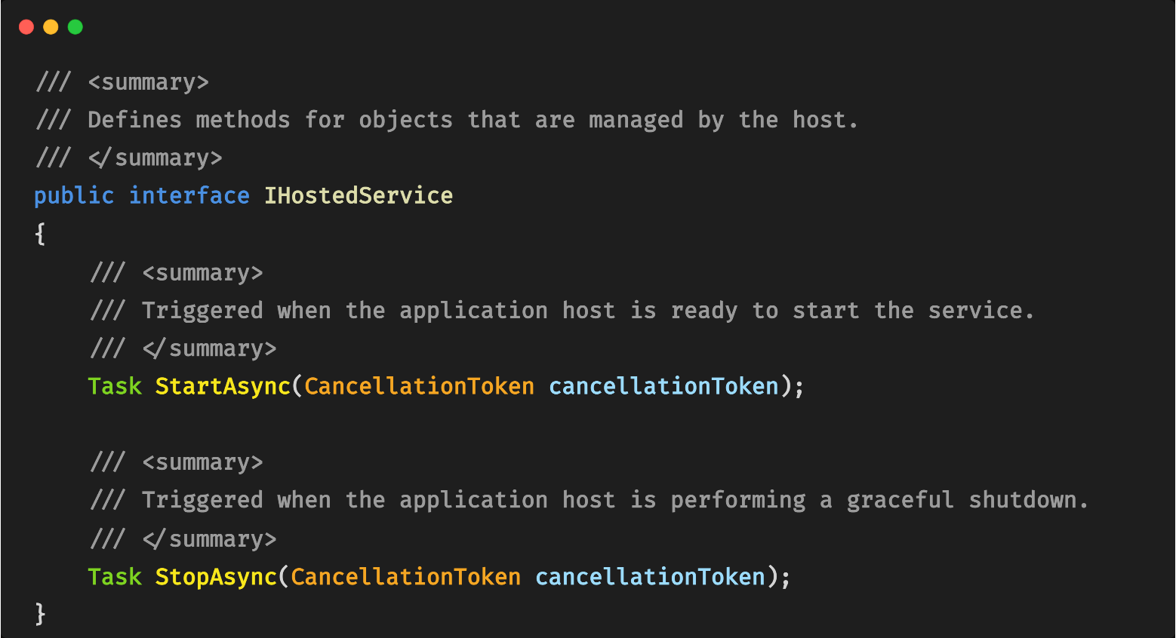
Hosted Service interface

Slide 13
Hosted Services within Host
HOST
Logging
Configuration
Dependency Injection (DI)
Hosted Services
Service A
Service B
Start
Stop
Start
Stop

Slide 14
Hosted Services before .NET 8

Slide 15
Hosted Services before .NET 8
Before .NET 8, host starts and stops hosted services does so sequentially. Each IHostedService registered with the DI container is started in sequence by calling the StartAsync method on the instance. It’s required to complete before the next service triggered.
Means host will run each service and won’t go for next one until the current one finish its Start method.

Slide 16
Hosted Services before .NET 8
HOST
Logging
Configuration
Dependency Injection (DI)
Host.Run()
Hosted Services
Service A
Start
Stop
FIFO order
Service B
Start
Stop

Slide 17
Hosted Services before .NET 8
HOST
Logging
Configuration
Dependency Injection (DI)
Host.Run()
Hosted Services
LIFO order
Service A
Start
Stop
Service B
Start
Stop
Host.Stop()

Slide 18
What could be an issue?
Slow application warm-up
Scaling issue
Possibility of not shutting down gracefully (may data inconsistency)

Slide 19
New .NET 8 features for Hosted Services

Slide 20
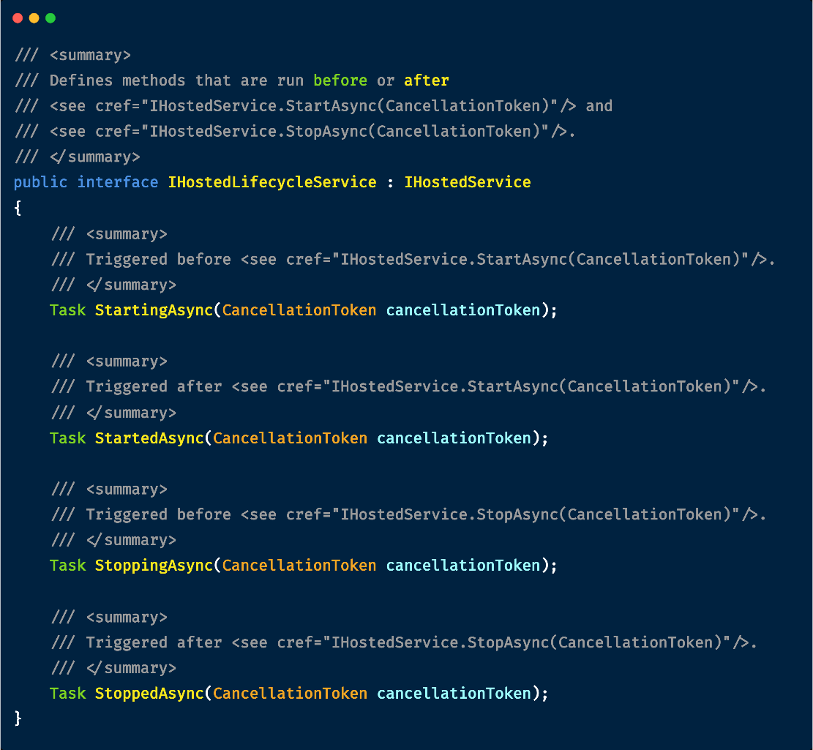

IHostedLifecycleService Having more control over hosted services
New .NET 8 features
for Hosted Services:
StartingAsync
StartAsync
StartedAsync

Slide 21
Concurrent Hosted Services In .NET 8, we are gaining two new options which allow us to switch to a concurrent start and/or stop behavior. To achieve this, we can configure the HostOptions and set one or both of the new properties to true to enable concurrent logic for starting or stopping any registered IHostedServices.
New .NET 8 features for Hosted Services

Slide 22
Concurrent Hosted Services .NET 8
HOST
Logging
Configuration
Dependency Injection (DI)
Host.Run()
Hosted Services
Service A
Service B
Start
Stop
Start
Stop
Host.Stop()

Slide 23
Demo

Slide 24
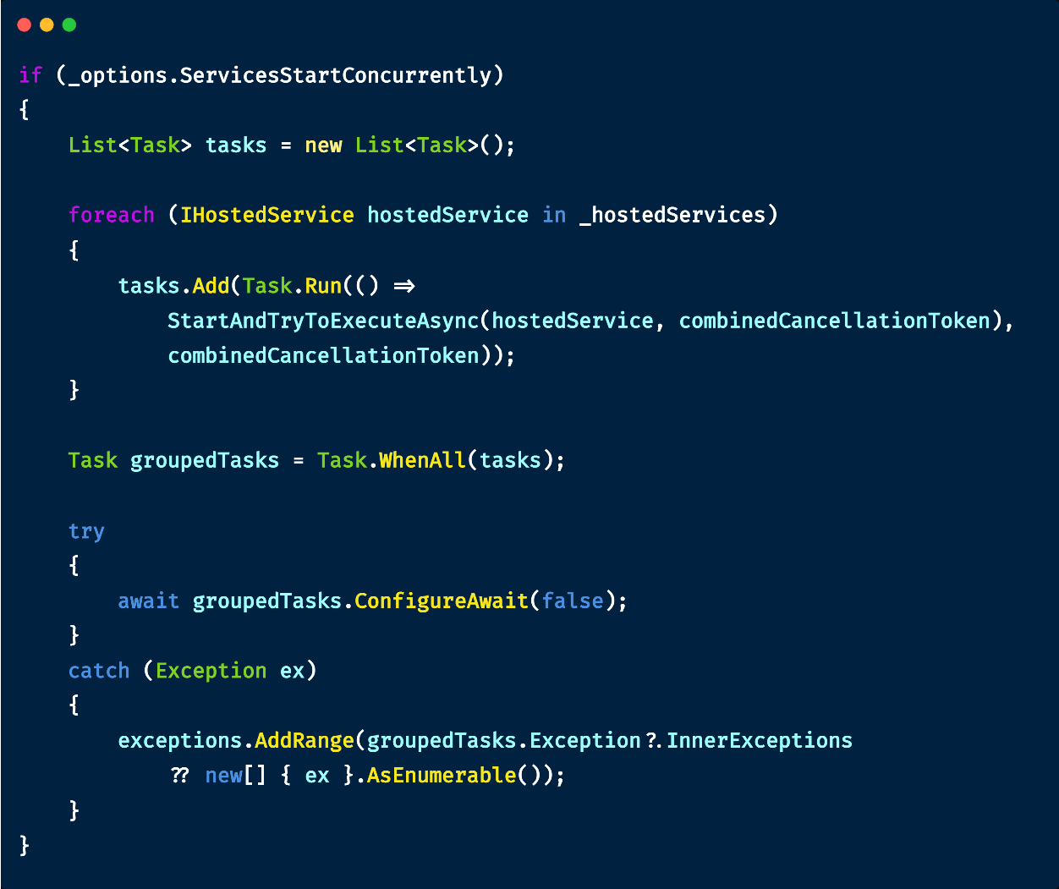
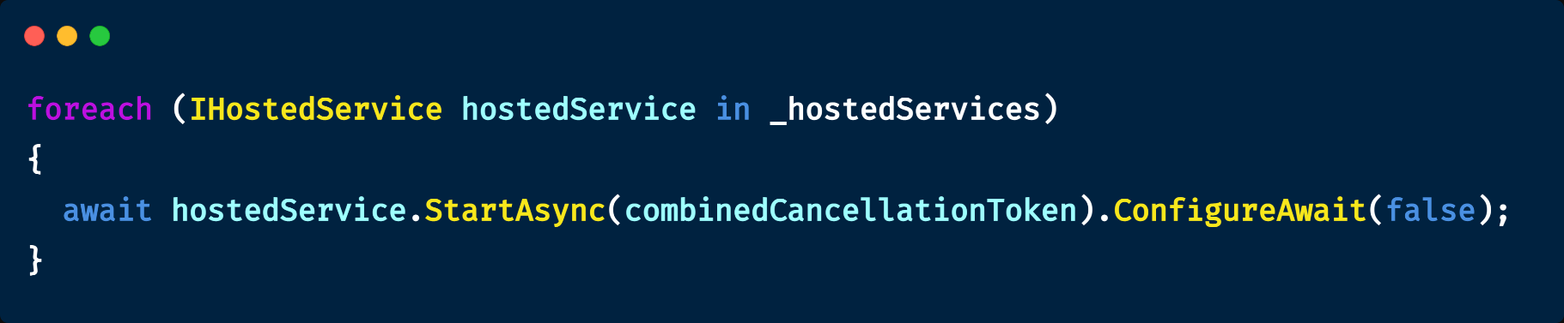
Host code (similar)
.NET 8
Before .NET 8

Slide 25
Concurrent HostedServices feature is a small but valuable addition, as it provides flexibility alongside the existing default sequential behavior. While switching to concurrent mode is generally safe for most applications, it's important to be cautious in situations where services depend on each other, as concurrent starting or stopping of services can potentially lead to application bugs due to the lack of guaranteed service registration order.
Takeaways

